Slide 1
HASHTABLE

Slide 2
How did we get Here?
In Arrays and ArrayList we can access elements based on index but if dealing with many elements it difficult to remember the index of each and every element , so it is easier to access elements using a key instead of an index. This is where we need Hash Table.
The Hashtable in C# is a Non-Generic Collection that stores the element in the form of “Key-Value Pairs”. The data in the Hashtable are organized based on the hash code of the key. The key in the HashTable is defined by us and more importantly, that key can be of any data type. Once we created the Hashtable collection, then we can access the elements by using the keys.
The Hashtable computes a hash code for each key. Then it uses that hash code to look up the elements very quickly which increases the performance of the application.

Slide 3
Characteristics of a HashTable
The Hashtable Collection Class in C# stores the elements in the form of key-value pairs.
Hashtable Class belongs to System.Collection namespace i.e. it is a Non-Generic Collection class.
It implements the IDictionary interface.
The Keys can be of any data type but they must be unique and not null.
The Hashtable accepts both null and duplicate values.
We can access the values by using the associated key.
The capacity of a Hashtable is the number of elements that a Hashtable can hold.
A hashtable is a non-generic collection, so we can store elements of the same type as well as of different types.

Slide 4
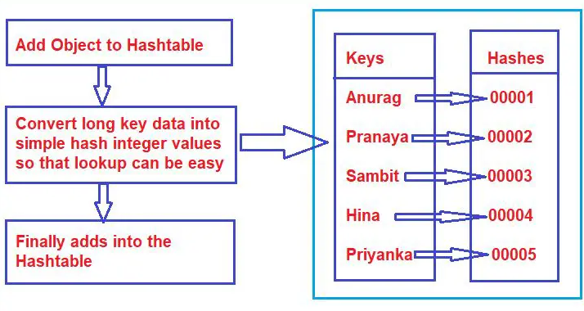
How A Hashtable works
When we add elements to a hashtable like string, int, or complex types, then it converts the key data which can be a string, integer, numeric, or anything in the world into simple hash integer values so that lookup can be easy. Once the conversion is done, then the data will be added to the hashtable collection. For a better understanding, please have a look at the below image. The performance of the hashtable is less as compared to the ArrayList because of this key conversion (converting the key to an integer hashcode).

Slide 5
Differences between ArrayList and Hashtable in C#:
Lookup: ArrayList can be only looked up via the index number which is generated internally. Hashtable can be looked up by a custom-defined key.
Performance: Hashtable is faster than hashtable because of extra tasks performed in hashtables i.e. hashing.
Scenario: If you want a key lookup use hashtable. If you just want to add and browser through a collection then use ArrayList.

Slide 6
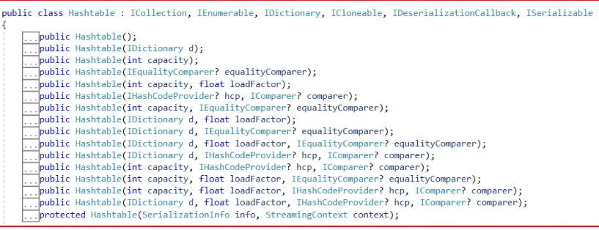

How to Create a Hashtable
In C# creating a hashtable we can use 16 different types of constructor
To create a hashtable create an instance of the hashtable class using one of the above constructors.

Slide 7
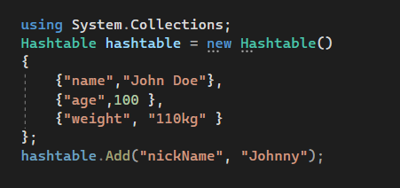
Adding Elements into the HashTable
Add(object key, object? value): The Add(object key, object? value) method is used to add an element with the specified key and value into the Hashtable. Here, the parameter key specifies the key of the element to add and the parameter value specifies the value of the element to add. The value can be null.

Slide 8
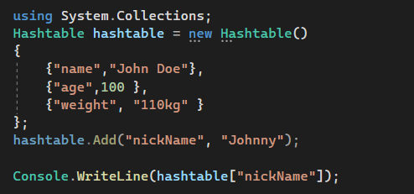

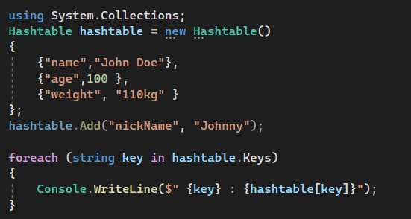
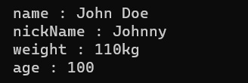
Accessing a Hash Table
Using Keys to access Hashtable
Using a Foreach loop

Slide 9
Check on availability of a Key-Value Pair in HashTables
Contains(object key): The Contains(object key) method of the Hashtable is used to check whether the Hashtable contains a specific key. The parameter key to locating in the Hashtable object. It returns true if the Hashtable contains an element with the specified key; otherwise, false. If the key is null, then it will throw System.ArgumentNullException.
ContainsKey(object key): The ContainsKey(object key) method of the Hashtable is used to check if a given key is present in the Hashtable or not. The parameter key to locating in the Hashtable object. If the given key is present in the collection then it will return true else it will return false. If the key is null, then it will throw System.ArgumentNullException.
ContainsValue(object value): The ContainsValue(object value) Method of the Hashtable class is used to check if a value is present in the Hashtable or not. The parameter value to locate in the hashtable object. If the given value is present in the collection then it will return true else it will return false.

Slide 10
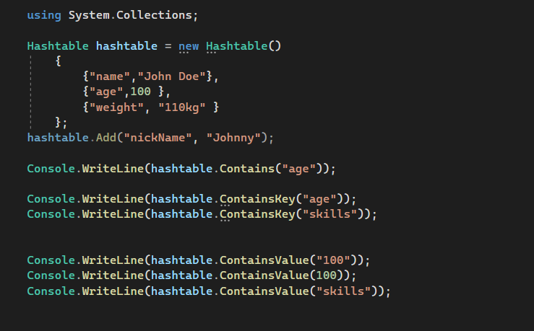
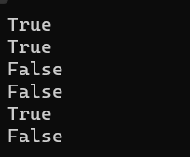

Slide 11
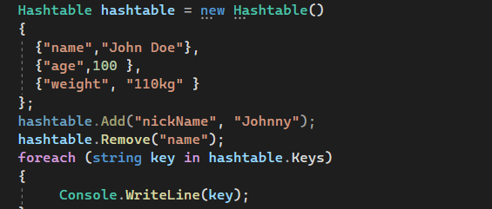

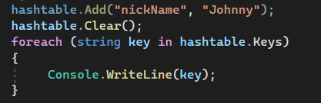
Removing an Element
Remove(object key): This method is used to remove the element with the specified key from the Hashtable. Here, the parameter key specifies the element to remove. It throws the KeyNotfoundException if the specified key is not found in the Hashtable, so check for an existing key using the ContainsKey() method before removing it.
Clear(): This method is used to remove all elements from the Hashtable

Slide 12
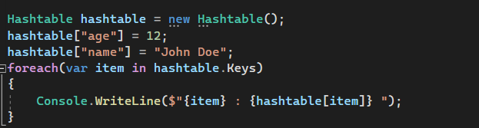

How to Assign Values to a Hashtable with Indexer in C#?
In order to add value to a Hashtable with an indexer, we need to use square brackets after the Hashtable name. This is because a Hashtable works with key/value pairs, we must have to specify both key and value while adding the elements. The key is specified between square brackets. The syntax is given below.

Slide 13
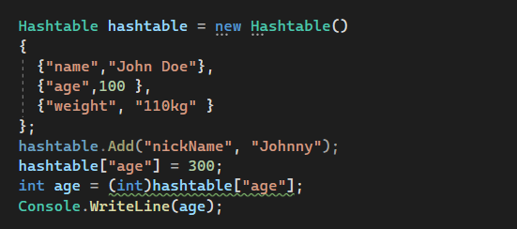

Updating a HashTable
We already discussed that we can retrieve the value from the Hashtable by using the key in the indexer. But the point that you need to remember is, that the Hashtable in C# is a non-generic collection class, so it is our responsibility to type-cast values to the appropriate type while retrieving it.

Slide 14
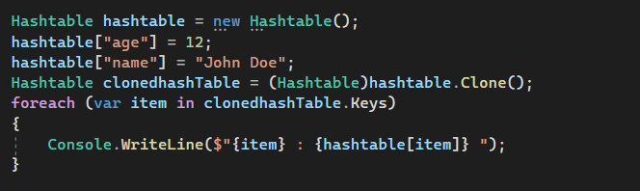

Clone a HashTable
Clone(): This method is used to create and return a shallow copy of a Hashtable object.

Slide 15
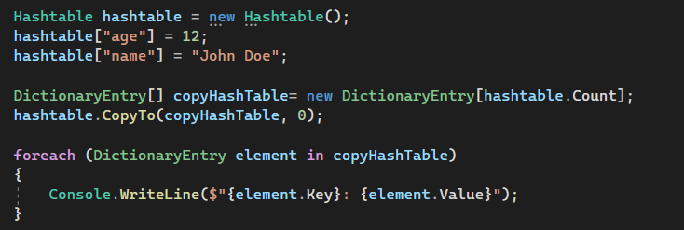

How to Copy a Hashtable to an Existing Array
CopyTo(Array array, int arrayIndex): The CopyTo method of the Non-Generic Hashtable Collection Class is used to copy hashtable elements to a one-dimensional Array object, starting at the specified index in the array. Here, the parameter array specifies the one-dimensional Array object that is the destination of the DictionaryEntry objects copied from the hashtable. The Array must have zero-based indexing. The arrayIndex parameter specifies the zero-based index in the array at which copying begins. If the parameter array is null, then it will throw ArgumentNullException. If the parameter arrayIndex is less than zero, then it will throw ArgumentOutOfRangeException.
To copy only the keys in the Hashtable, use Hashtable.Keys.CopyTo.
To copy only the values in the Hashtable, use Hashtable.Values.CopyTo.

Slide 16
HashTable Properties
IsFixedSize: Gets a value indicating whether the System.Collections.Hashtable has a fixed size. It returns true if the Hashtable object has a fixed size; otherwise, false. The default is false.
Keys: Gets a System.Collections.ICollection containing the keys in the Hashtable. It returns a System.Collections.ICollection containing the keys in the Hashtable.
IsSynchronized: Gets a value indicating whether access to the Hashtable is synchronized (thread-safe). It returns true if access to the Hashtable is synchronized (thread-safe); otherwise, false. The default is false.
IsReadOnly: Gets a value indicating whether the Hashtable is read-only. It returns true if the Hashtable object is read-only; otherwise, false. The default is false.
Count: Gets the number of key/value pairs contained in the Hashtable. It returns the number of key/value pairs contained in the System.Collections.Hashtable.
Values: Gets a System.Collections.ICollection containing the values in the Hashtable. It returns a System.Collections.ICollection containing the values in the Hashtable.
SyncRoot: Gets an object that can be used to synchronize access to the Hashtable. It returns an object that can be used to synchronize access to the Hashtable.
comparer: Gets or sets the System.Collections.IComparer to use for the Hashtable. It returns the System.Collections.IComparer to use for the Hashtable.
hcp: Gets or sets the object that can dispense hash codes. It returns the object that can dispense hash codes.
EqualityComparer: Gets the System.Collections.IEqualityComparer to use for the Hashtable. It returns the System.Collections.IEqualityComparer to use for the Hashtable.

